Slide 1
Poisson Matting
Jian Sun1 Jiaya Jia2∗ Chi-Keung Tang2 Heung-Yeung Shum1
1Microsoft Research Asia 2Hong Kong University of Science and Technology
ACM Transactions on Graphics (TOG) Volume 23 Issue 3, August 2004
Pages 315-321

Slide 2
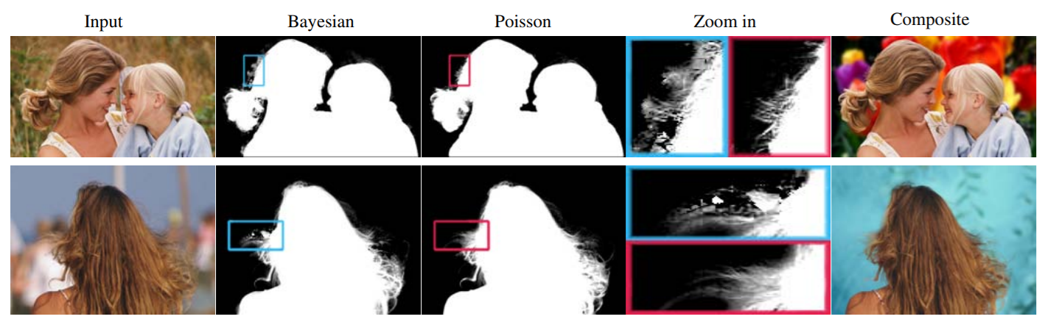
What is Poisson matting?

Slide 3
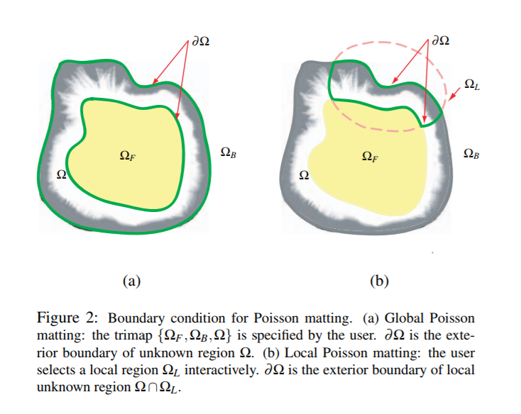
Poisson Matting
If it fails to produce high quality mattes due to a complex background
Global Poisson matting
Local Poisson matting

Slide 4
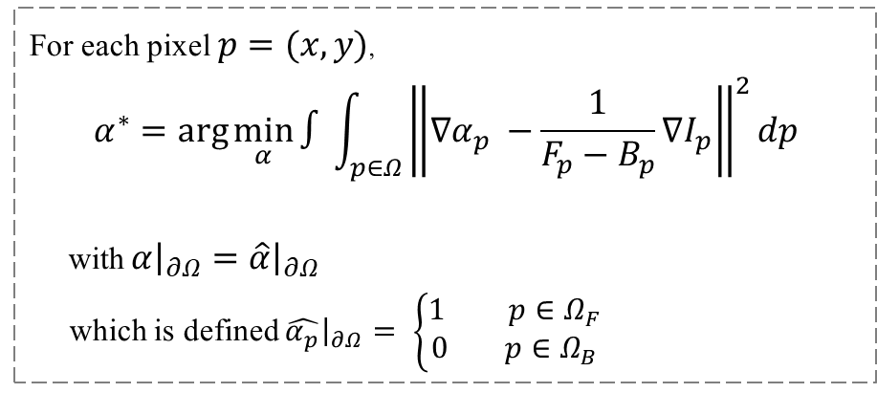
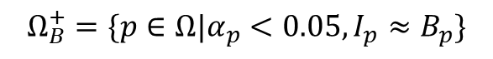
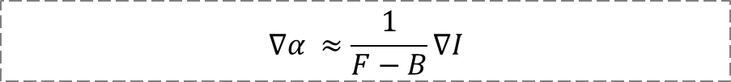
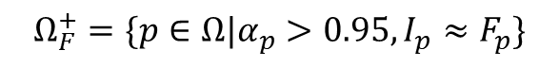
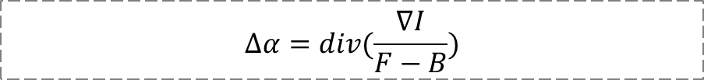
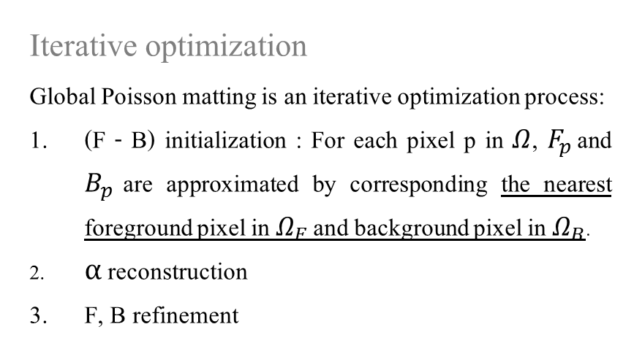
Global Poisson Matting
$$∇α ≈\frac{1}{F−B}∇I$$
Iterative optimization
Global Poisson matting is an iterative optimization process:
(F - B) initialization : For each pixel p in $Ω$, $F_{p}$ and $B_{p}$ are approximated by corresponding the nearest foreground pixel in $Ω_{F}$ and background pixel in $Ω_{B}$.
α reconstruction
F, B refinement
For each pixel $p=(x,y)$,
$$α^{∗}=\arg{\min_{α}{∫\int_{p∈Ω}{{\left\|∇α_{p} −\frac{1}{F_{p}−B_{p}}∇I_{p}\right\|}^{2}dp}}}$$
with $α{\left.​\right|}_{∂Ω}=\hat{α}{\left.​\right|}_{∂Ω}$
which is defined $\hat{α_{p}}{\left.​\right|}_{∂Ω}= \left\{\begin{aligned}1 p∈Ω_{F} \\ 0 p∈Ω_{B}\end{aligned}\right.$
$$Ω_{F}^{+}=\{p∈Ω|α_{p}>0.95, I_{p}≈F_{p}\}$$
$$Ω_{B}^{+}=\{p∈Ω|α_{p}<0.05, I_{p}≈B_{p}\}$$
$$∆α=div(\frac{∇I}{F−B})$$

Slide 5
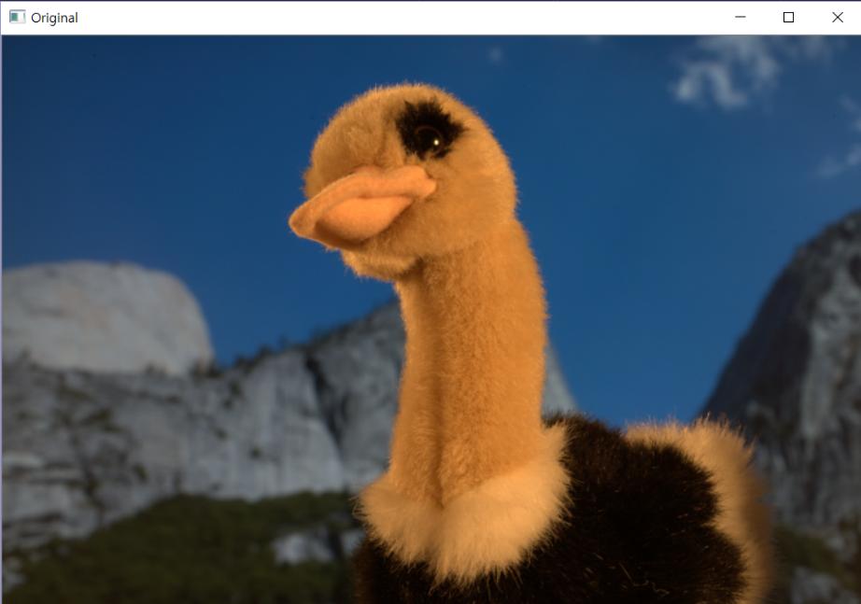
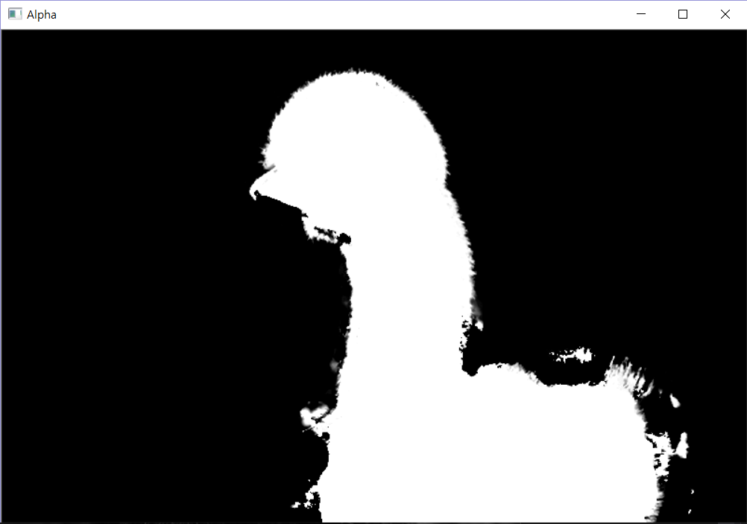
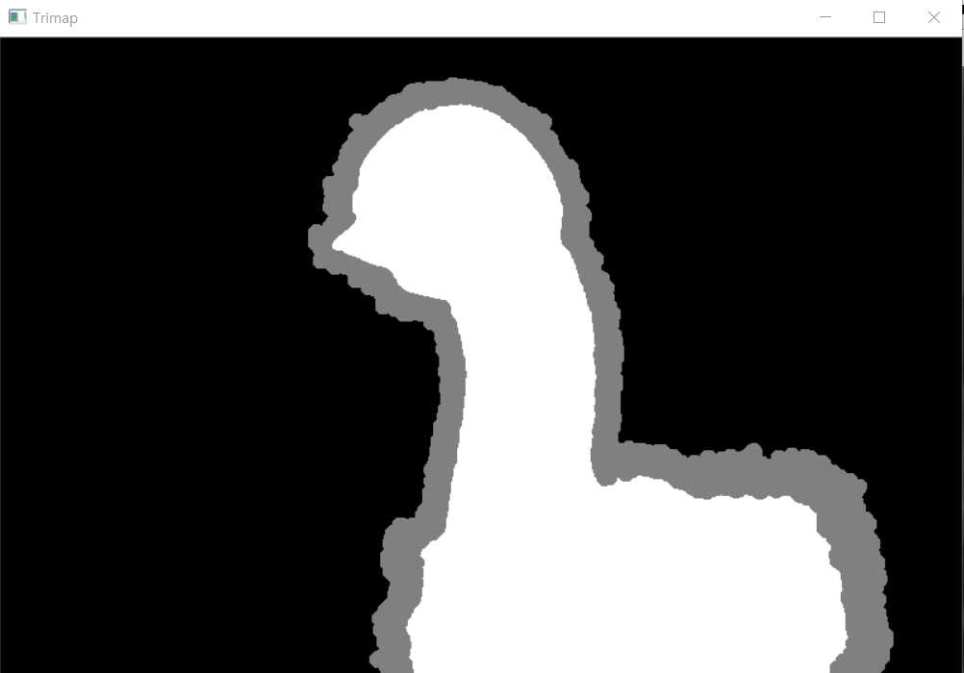
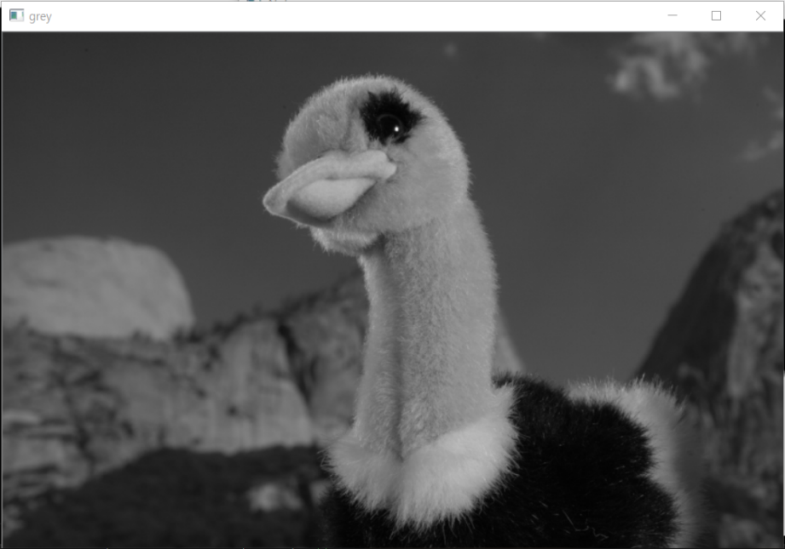

Slide 6


Global Poisson Matting in the colourscale channel
Problem
Solution
$$\left(F−B\right)∇α=∇I$$
$$∆α=div(\frac{∇I}{F−B})$$
$$\left(F−B\right)∙(F−B)∇α=(F−B)∙∇I$$
Grey Scale
Colour Scale
$$∇α=\frac{\left(F−B\right)∙∇I}{{\left|\left|F−B\right|\right|}^{2}}$$

Slide 7
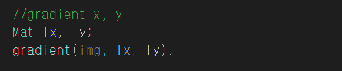
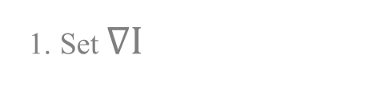
Global Poisson Matting
1. Set $∇I$
void gradient(cv::Mat src, cv::Mat& x, cv::Mat& y) {
x.create(src.size(), CV_32FC3);
y.create(src.size(), CV_32FC3);
for (int i = 0; i < src.rows; i++){
for (int j = 0; j < src.cols; j++){
if (i == 0) y.at < Vec3f >(i, j) = src.at<Vec3f>(i + 1, j) - src.at<Vec3f>(i, j);
else if (i == src.rows - 1) y.at<Vec3f>(i, j) = src.at<Vec3f>(i, j) - src.at<Vec3f>(i - 1, j);
else y.at<Vec3f>(i, j) = (Vec3f)(src.at<Vec3f>(i + 1, j) - src.at<Vec3f>(i - 1, j)) / 2;
if (j == 0) x.at<Vec3f>(i, j) = src.at<Vec3f>(i, j + 1) - src.at<Vec3f>(i, j);
else if (j == src.cols - 1) x.at<Vec3f>(i, j) = src.at<Vec3f>(i, j) - src.at<Vec3f>(i, j - 1);
else x.at<Vec3f>(i, j) = (Vec3f)(src.at<Vec3f>(i, j + 1) - src.at<Vec3f>(i, j - 1)) / 2;
}}}

Slide 8
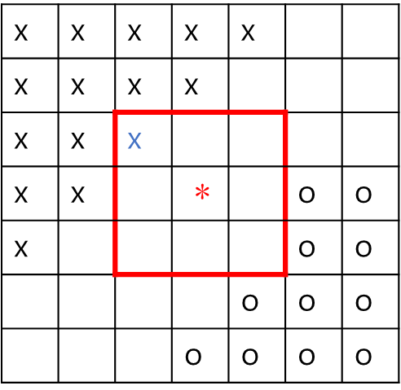
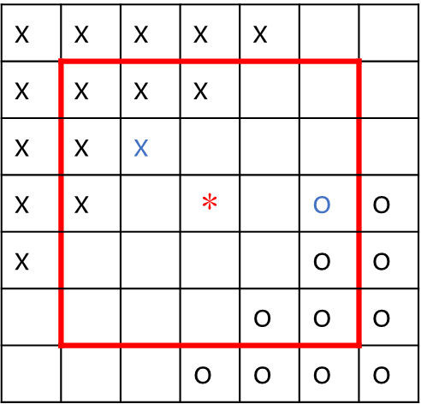
Global Poisson Matting
2. Find the nearest F and B from the unknown pixel and initialise (F-B) value
x | x | x | x | x
x | x | x | x
x | x | x
x | x |  | $\text{∗}$ |  | o | o
x |  |  |  |  | o | o
 |  |  |  | o | o | o
 |  |  | o | o | o | o
x | x | x | x | x
x | x | x | x
x | x | x
x | x |  | $$\text{∗}$$ |  | o | o
x |  |  |  |  | o | o
 |  |  |  | o | o | o
 |  |  | o | o | o | o
x : Definitely background
o : Definitely foreground
<How to find the nearest F and B>

Slide 9
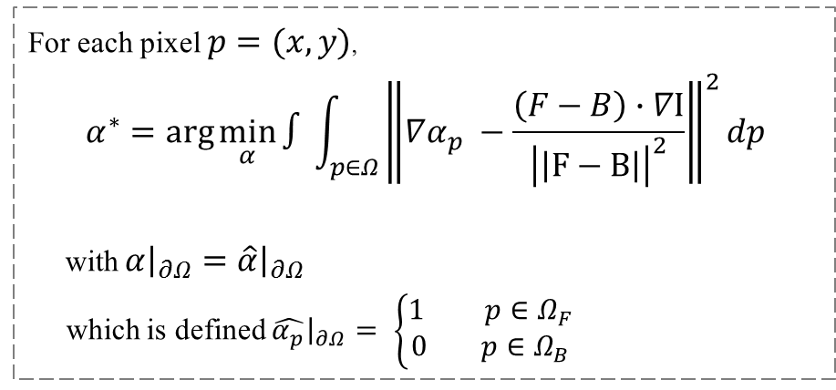
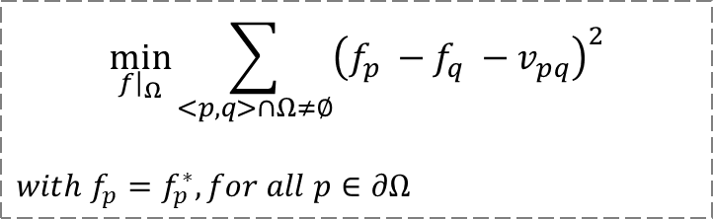
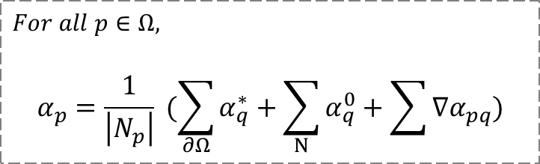
Global Poisson Matting
3. 𝛼 reconstruction
Discrete Poisson solver
$$\min_{f{\left.​\right|}_{Ω}}{\sum_{<p,q>∩Ω≠∅}{{\left(f_{p} −f_{q} −v_{pq}\right)}^{2}}}$$
$$with f_{p}=f_{p}^{∗}, for all p∈∂Ω$$
For each pixel $p=(x,y)$,
$$α^{∗}=\arg{\min_{α}{∫\int_{p∈Ω}{{\left\|∇α_{p} −\frac{\left(F−B\right)∙∇I}{{\left|\left|F−B\right|\right|}^{2}}\right\|}^{2}dp}}}$$
with $α{\left.​\right|}_{∂Ω}=\hat{α}{\left.​\right|}_{∂Ω}$
which is defined $\hat{α_{p}}{\left.​\right|}_{∂Ω}= \left\{\begin{aligned}1 p∈Ω_{F} \\ 0 p∈Ω_{B}\end{aligned}\right.$
$$For all p∈Ω,$$
$$α_{p}=\frac{1}{\left|N_{p}\right|} (\sum_{∂Ω}{α_{q}^{∗}}+\sum_{N}{α_{q}^{0}}+\sum{∇α_{pq}})$$
Patrick P´erez∗, Michel Gangnet†, Andrew Blake‡, “Poisson Image Editing ”, Microsoft Research UK, 2003

Slide 10

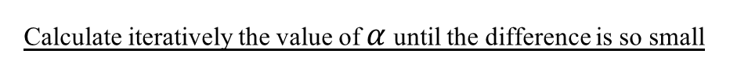
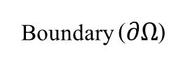
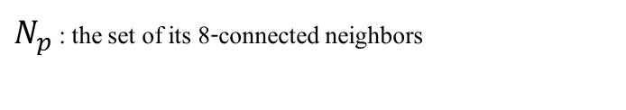
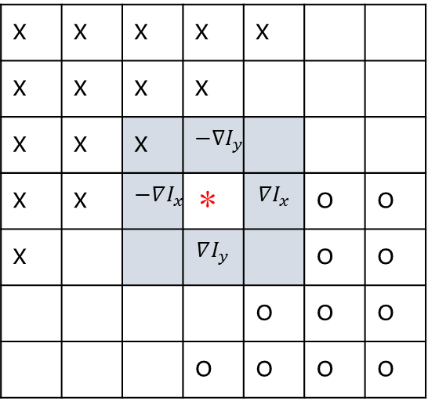
Global Poisson Matting
Discrete Poisson solver
Boundary ($∂Ω$)
$$For all p∈Ω,$$
$$α_{p}=\frac{1}{\left|N_{p}\right|} (\sum_{∂Ω}{α_{q}^{∗}}+\sum_{N}{α_{q}^{0}}+\sum{∇α_{pq}})$$
x | x | x | x | x
x | x | x | x
x | x | x | $$−∇I_{y}$$
x | x | $$−∇I_{x}$$ | $$\text{∗}$$ | $$∇I_{x}$$ | o | o
x |  |  | $$∇I_{y}$$ |  | o | o
 |  |  |  | o | o | o
 |  |  | o | o | o | o
$N_{p}$ : the set of its 8-connected neighbors
: the set of q
x : Definitely background
o : Definitely foreground
Calculate iteratively the value of $α$ until the difference is so small

Slide 11
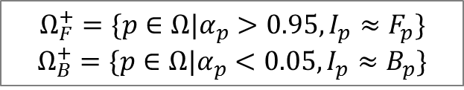
Global Poisson Matting
4. F and B refinement
Vec3f second_con;
if (1> alpha1.at<float>(y, x)&&alpha1.at<float>(y, x) > 0.95) {
for (auto& NB_pixel : neighbour_pixels) {
if (NB_pixel.p == Point(x, y)) {
second_con = img.at<Vec3f>(y, x) - NB_pixel.F_pixel;
if (dot(second_con, second_con) < 0.0001) {
trimap.at<uchar>(y, x) = WHITE;}
break;}}}
if (0 < alpha1.at<float>(y, x) && alpha1.at<float>(y, x)< 0.05) {
for (auto& NB_pixel : neighbour_pixels) {
if (NB_pixel.p == Point(x, y)) {
second_con = img.at<Vec3f>(y, x) - NB_pixel.B_pixel;
if (dot(second_con, second_con) < 0.0001) {
trimap.at<uchar>(y, x) = BLACK;}
break;}}}
$$Ω_{F}^{+}=\{p∈Ω|α_{p}>0.95, I_{p}≈F_{p}\}$$
$$Ω_{B}^{+}=\{p∈Ω|α_{p}<0.05, I_{p}≈B_{p}\}$$

Slide 12
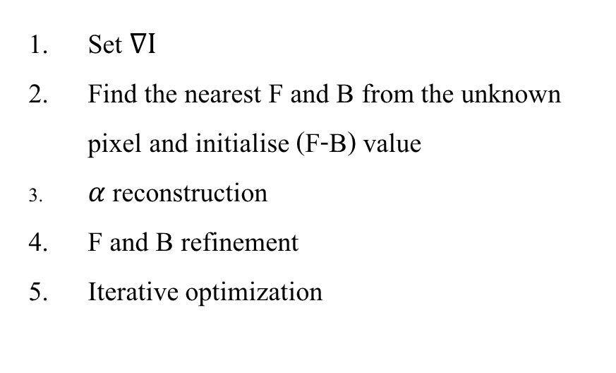
Global Poisson Matting
5. Iterative optimization
Mat alpha;
trimap.convertTo(alpha, CV_32F, 1 / 255.f); //from 0 to 1
int result;
for (int i = 0; i < 50; i++) {
result = Iterative_opti(trimap, img, alpha);
if (result == 1) break;
imshow("Alpha", alpha);
waitKey(10);
}
Set $∇I$
Find the nearest F and B from the unknown pixel and initialise (F-B) value
𝛼 reconstruction
F and B refinement
Iterative optimization

Slide 13
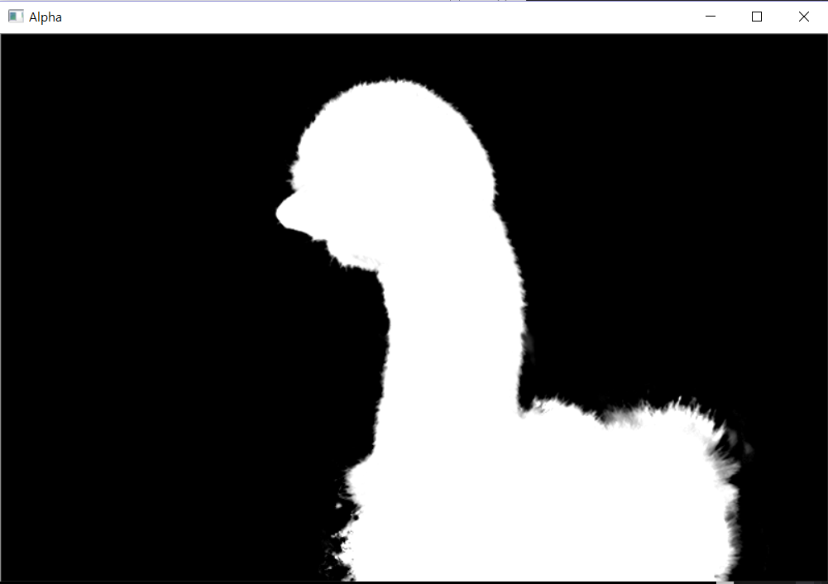

Slide 14
Alpha mattes based on the greyscale and the colourscale
Grey
Colour

Slide 15
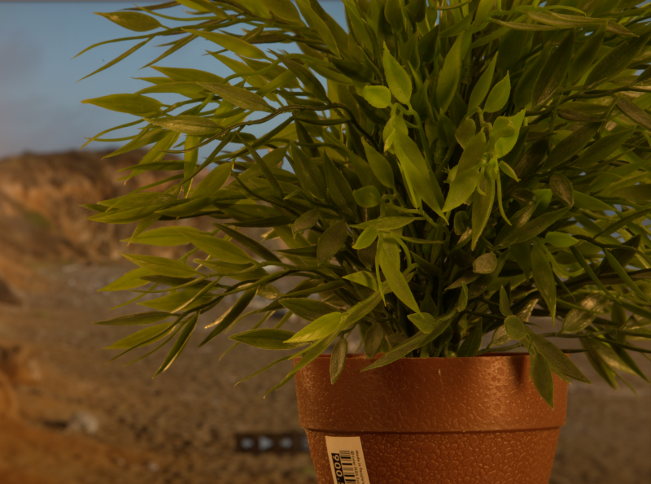
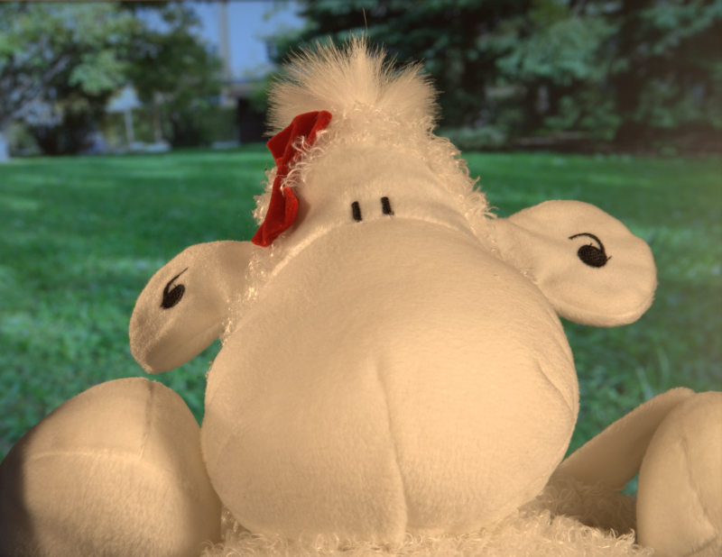
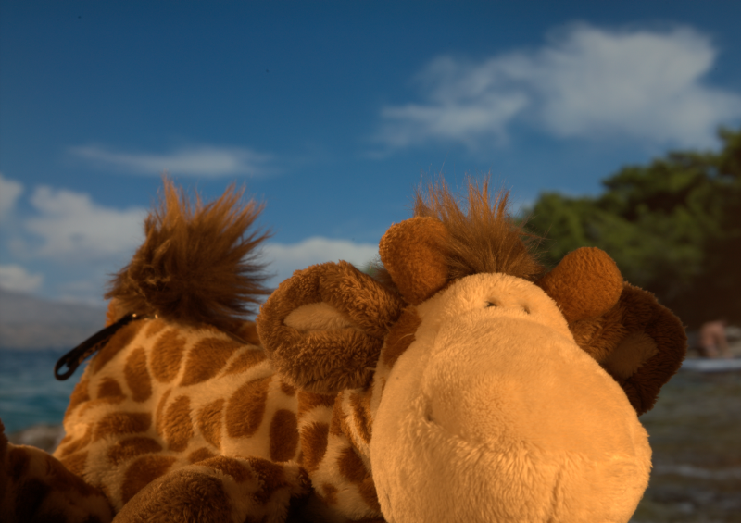
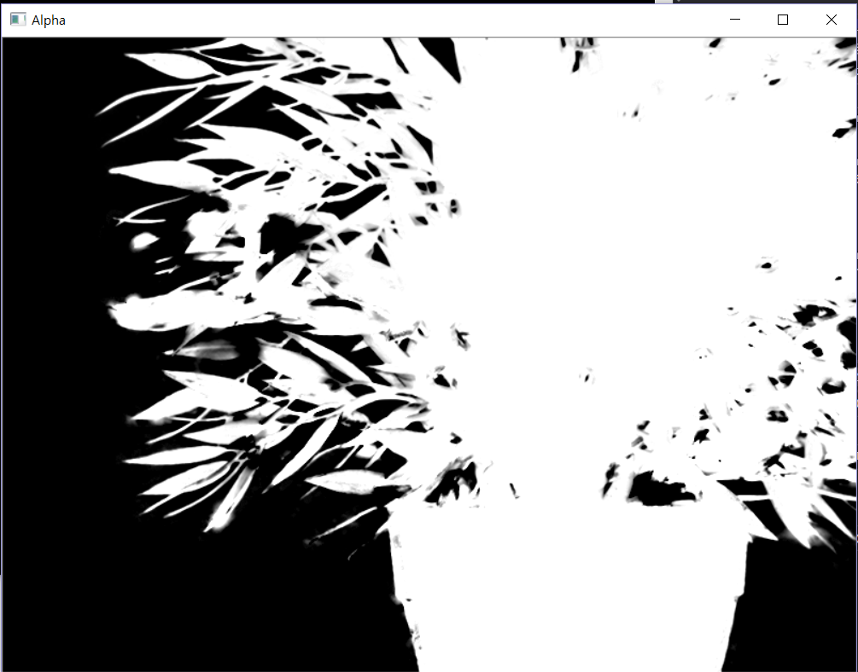
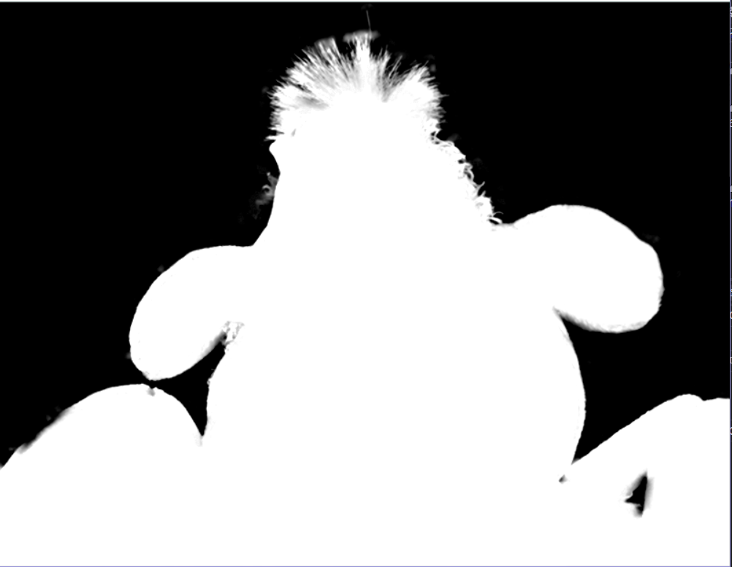
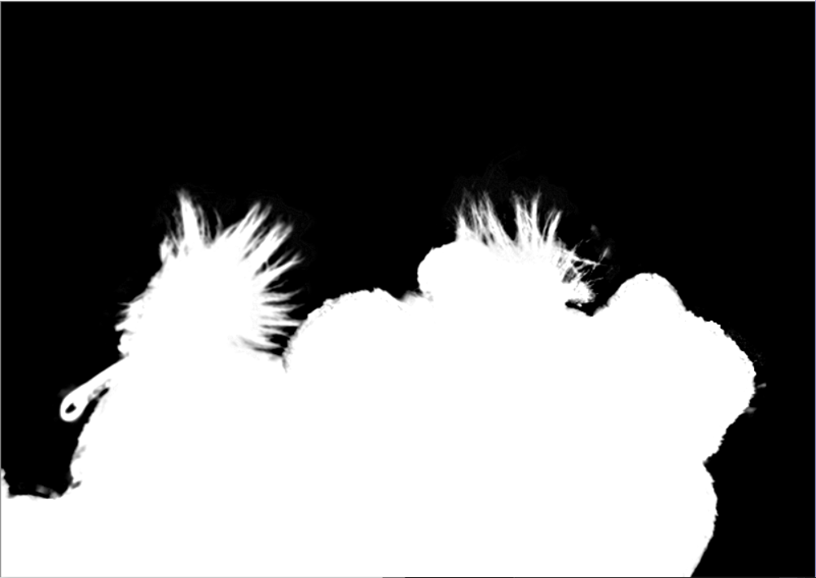

Slide 16
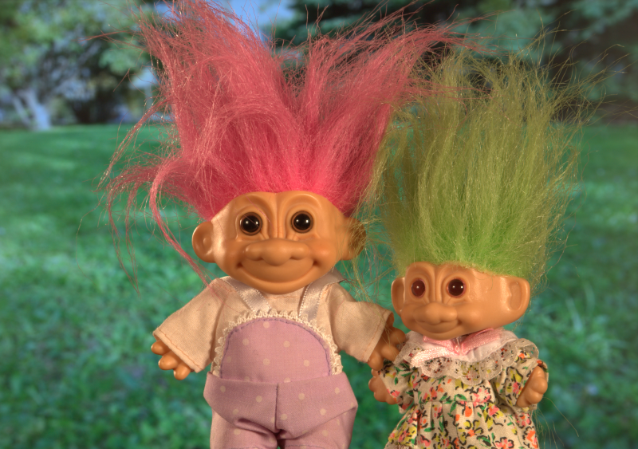
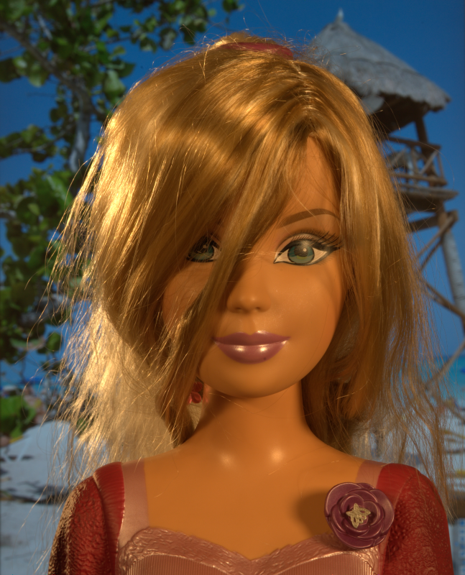
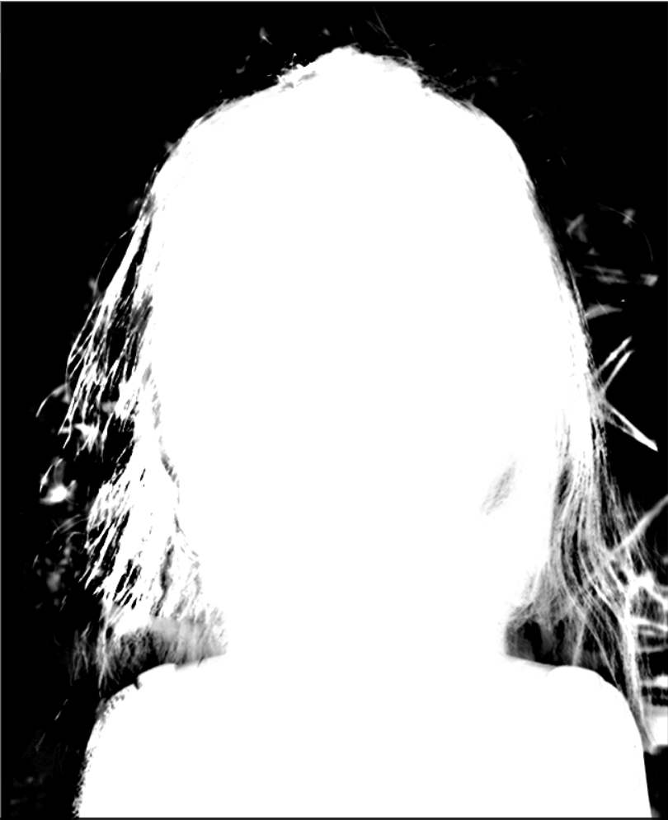
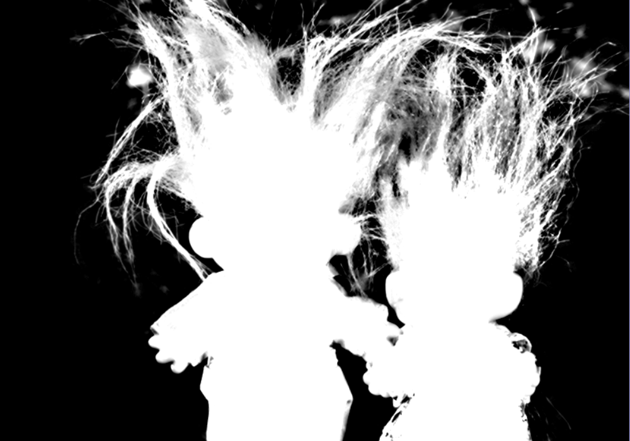

Slide 17
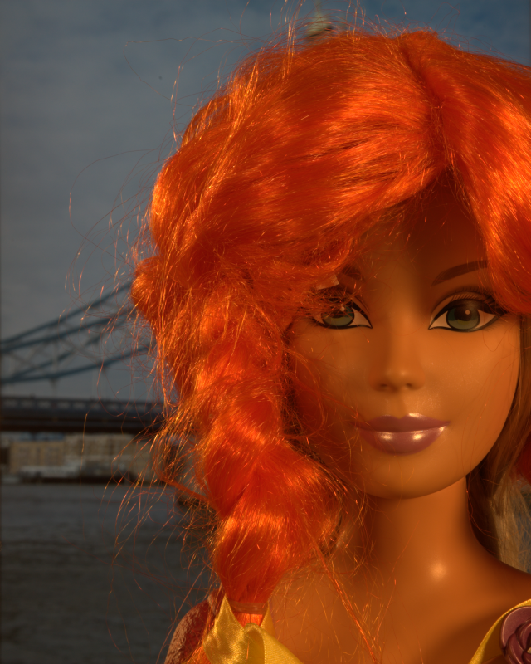
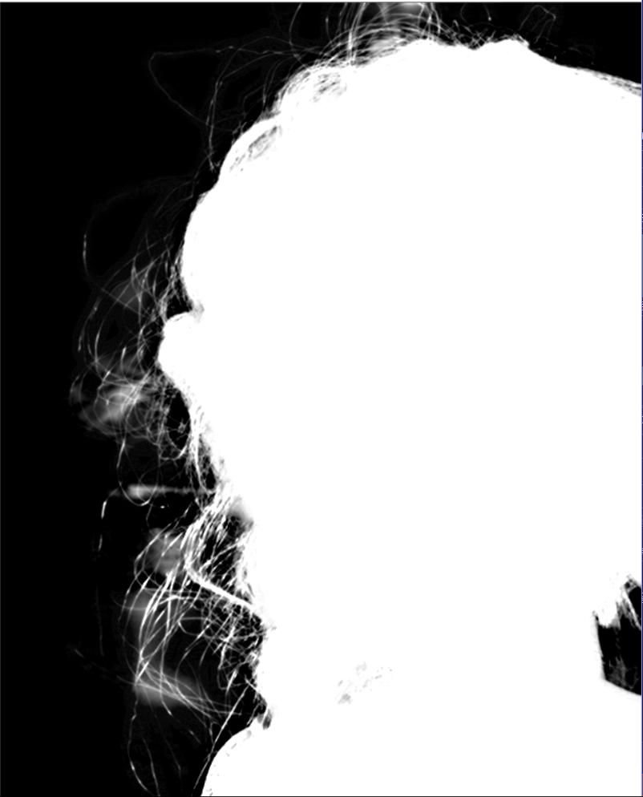

Slide 18
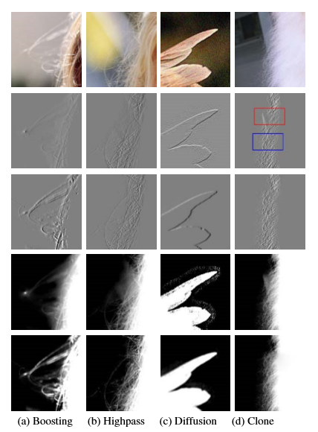
Local Poisson Matting
Channel selection
To reduce the error of D
Boosting brush
Highpass filtering
Diffusion filtering
Clone brush
Erase brush / Inverse Brush
Local filtering
To manipulate A and D

Slide 19
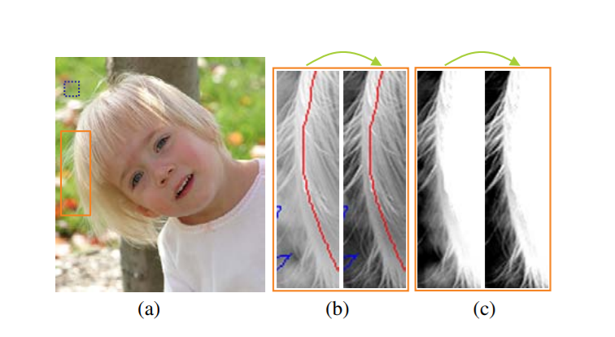

Local Poisson Matting
Channel Selection
$$\min_{a,b,c}{\sum_{i}{{\left[\left(a b c\right)∙{\left(R_{i} G_{i} B_{i}\right)}^{T} −\left(a b c\right)∙(\overline{R} \overline{G} \overline{B}) \right]}^{2}} s.t. a+b+c=1}$$
A new channel $γ=aR+bG+cB$
The error of D is reduced and the hair shape is better recovered.

